Slide 1

C Language Library Management System
This presentation explores the development of a Library Management System (LMS) using the C programming language. The system addresses the challenges faced by libraries without automated management, such as cataloging, inventory, and patron record maintenance. Our project aims to streamline these processes, enhance efficiency, and provide a user-friendly experience for both librarians and patrons. We will delve into the system's features, code structure, and its practical applications in modern libraries.

Slide 2

Pathway to the Presentation
1
Problem Statement
2
Introduction
Libraries lacking management systems face challenges in cataloging, inventory, and patron record maintenance.
Our project addresses these challenges by developing a Library Management System in C.
3
System Features
The system provides secure management, environmental friendliness, and improved relations within the university.

Slide 3
Addressing the Problem Statement
Challenges
Solutions
Cataloging and organizing books
Automated cataloging process
Managing overdue books and fines
Efficient tracking of inventory
Maintaining patron records
Online viewing of books
Difficulty scaling the library
User-friendly interface
Libraries without a library management system face problems with cataloging and organizing books, managing overdue books and fines, and maintaining patron records, which creates difficulty in scaling the library as it grows.

Slide 4
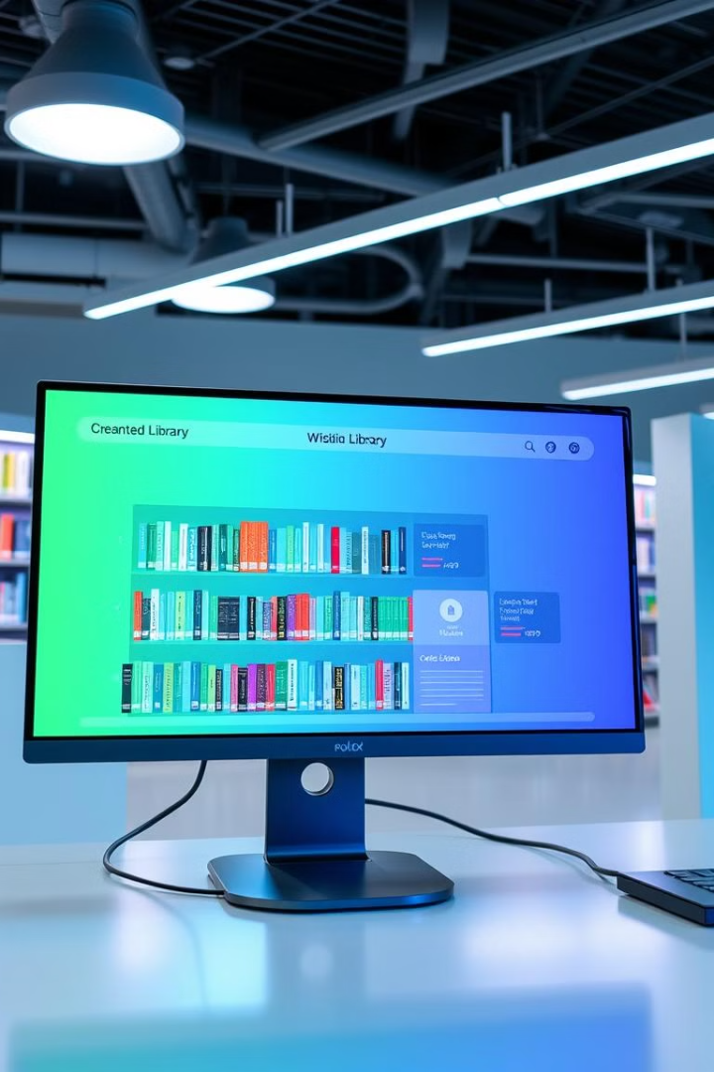
Introduction to the Library Management System
Efficiency and Productivity
Data Maintenance
The system helps increase efficiency and productivity through automation.
It helps maintain accurate and organized data.
Cost and Time Savings
The system is cost-effective and saves time.
Our topic for the problem-solving group project is 'Library Management System'. The concept of storing or recording the details of books embedded within the user's system is known as Library Management System. It details the types of books, the list of books, etc.

Slide 5

Header Files
#include <stdio.h>:
Standard I/O functions like printf() and scanf() for user interaction.
#include <stdlib.h>:
Utility functions like exit() to terminate the program if needed.
#include <string.h>:
String manipulation functions used:
fgets(): For safe input of strings with spaces (like book titles or author names).
strcspn(): To remove trailing newline characters from string inputs.
Why these headers are essential:
They provide the necessary built-in functions that simplify tasks like input/output handling and string operations.

Slide 6

Important Functions
addBook():
Purpose: Adds a new book to the library.
Inputs: Book ID, Title, Author, Quantity.
Process:
Takes inputs using scanf() and fgets().
Validates to ensure no trailing newline in the title or author.
Updates the book count to keep track of inventory.
displayBooks():
Purpose: Displays all available books in the library.
Checks if there are no books in the library.
Loops through the library[] array to display book details like ID, title, author, and quantity.
addMember():
Purpose: Registers a new member in the library.
Inputs: Member ID and Name.
Initializes booksIssued to 0 for every new member.
Ensures the member count is updated.
issueBook():
Purpose: Issues a book to a member.
Inputs: Member ID and Book ID.
Validates whether:
The book exists and is available (quantity > 0).
The member exists in the system.
Updates the quantity of the book and the books issued by the member.
main():
The central control of the program.
Provides a menu-driven interface for:
Adding books
Displaying books
Adding members
Issuing books
Exiting the system.
Uses a do-while loop for continuous interaction until the user opts to exit.

Slide 7
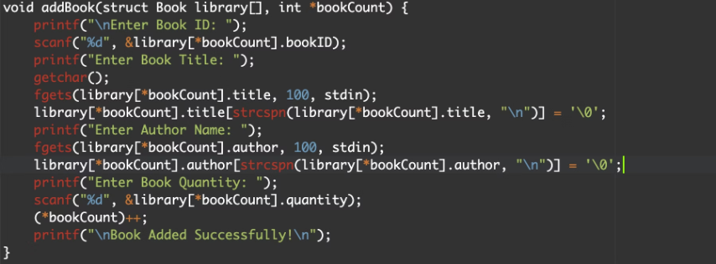
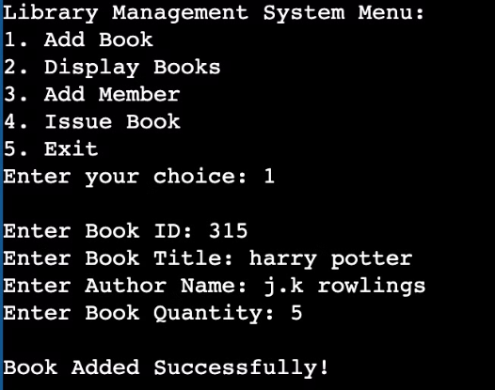
Code Implementation
source code
output
Adding a Book:

Slide 8
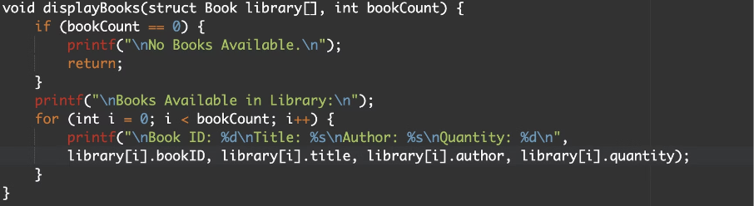
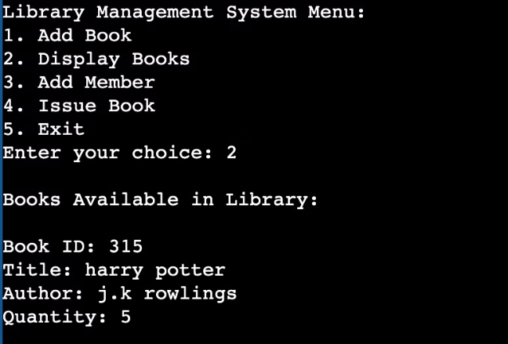
source code
output
Displaying Books:

Slide 9
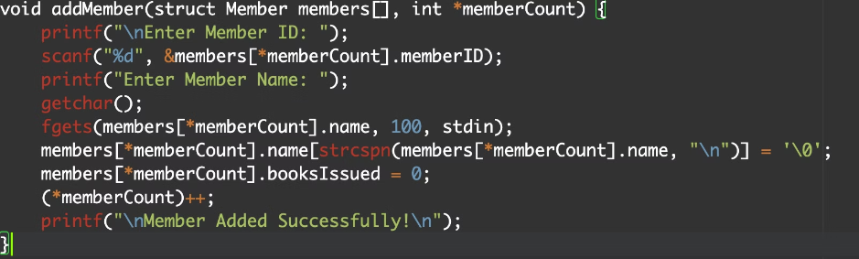
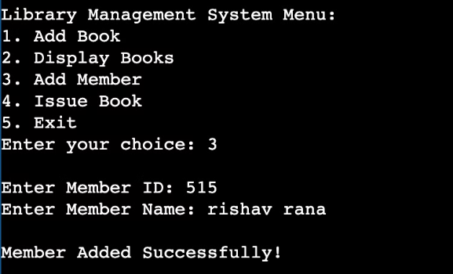
source code
output
Adding a Member :

Slide 10
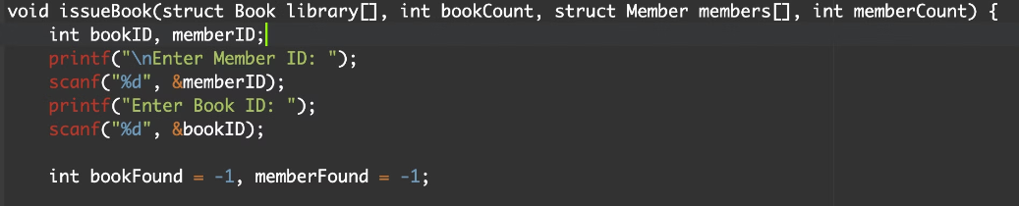
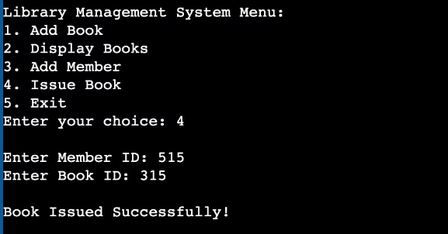
source code
output
Issuing a Book:

Slide 11



Conclusion
Efficiency
1
Increased productivity
Productivity
2
Time-saving processes
Technology
3
Enhanced management
The C language coded library management system project is a successful implementation of technology to manage library operations. This system streamlines tasks such as book search, checkout, and return, making it easier for both librarians and patrons.

Slide 12

References
Here are the references for our Library Management System.
C Programming Language (Book): Brian W. Kernighan and Dennis M. Ritchie.
Online C Documentation: cplusplus.com and geeksforgeeks.org
Classroom notes and guidance from instructors.

